Slide 1




AI Research
F24-4 Sprint Demo
`
© Conestoga College. All rights reserved.

Slide 2

Team
Copilot Studio | Tech
Arsh Chauhan | Hamna Ashraf
Paras Rupani | Wei-Hsiang Chen
 | Jongeon Lee

Slide 3

Sprint Goal
Enhancing the Chatbot Flow using Co-Pilot Studio.
Enhance accuracy and performance.
Developing for the Level 1 demo.
Notes:
At the end of the first week of the sprint, our plan changed to focus on proposing our project to the AI Steering Community. Even tough we did not have tremendous progress this week, we worked with a positive mindset.
We are refining the chatbot's flow using Co-Pilot Studio, ensuring seamless interactions.
Making enhancements to accuracy and performance allows us to deliver faster, more precise responses.
Currently, we're focused on developing a robust Level 1 demo, showcasing core capabilities and still working on level 2.

Slide 4
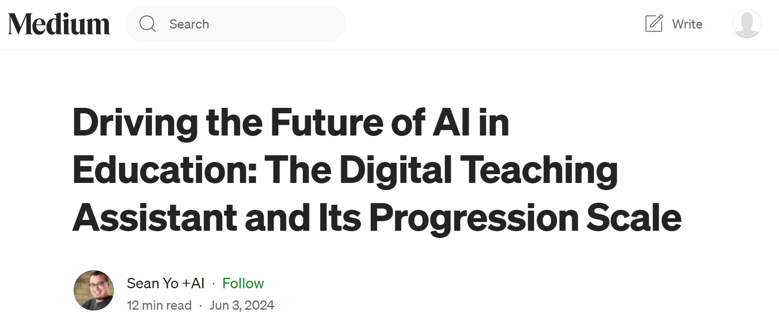
Digital Teaching Assistant (DTA)
Notes:
This medium article was published by Sean which focuses mainly on the digital teaching assistants which fundamentally are AI-powered systems designed to support personalized learning and offer real-time responses, and customized learning paths.
The DTA scale ranges from 0 to 5, where 0 would be no AI assistance and 5 would be fully automated system.
For now, we are mainly focusing on Level1 and 2,
Level 1 – Informational DTA:
Answers simple transactional questions.
Level 2 – Interpretive DTA:
Synthesizes course content to answer abstract questions.

Slide 5
Demo
What's the name of faculty for my courses?
What is in my week 4 for all three courses?
Are there any assignments due in that weeks?
What about exam weightage?
I am in week 8. Now tell me how many assignments are due next week?
Notes:
Here are the few queries that we asked the chatbot to interact with the instructional plan.
The program chosen in this demo is the Bachelor’s of Computer Science

Slide 6
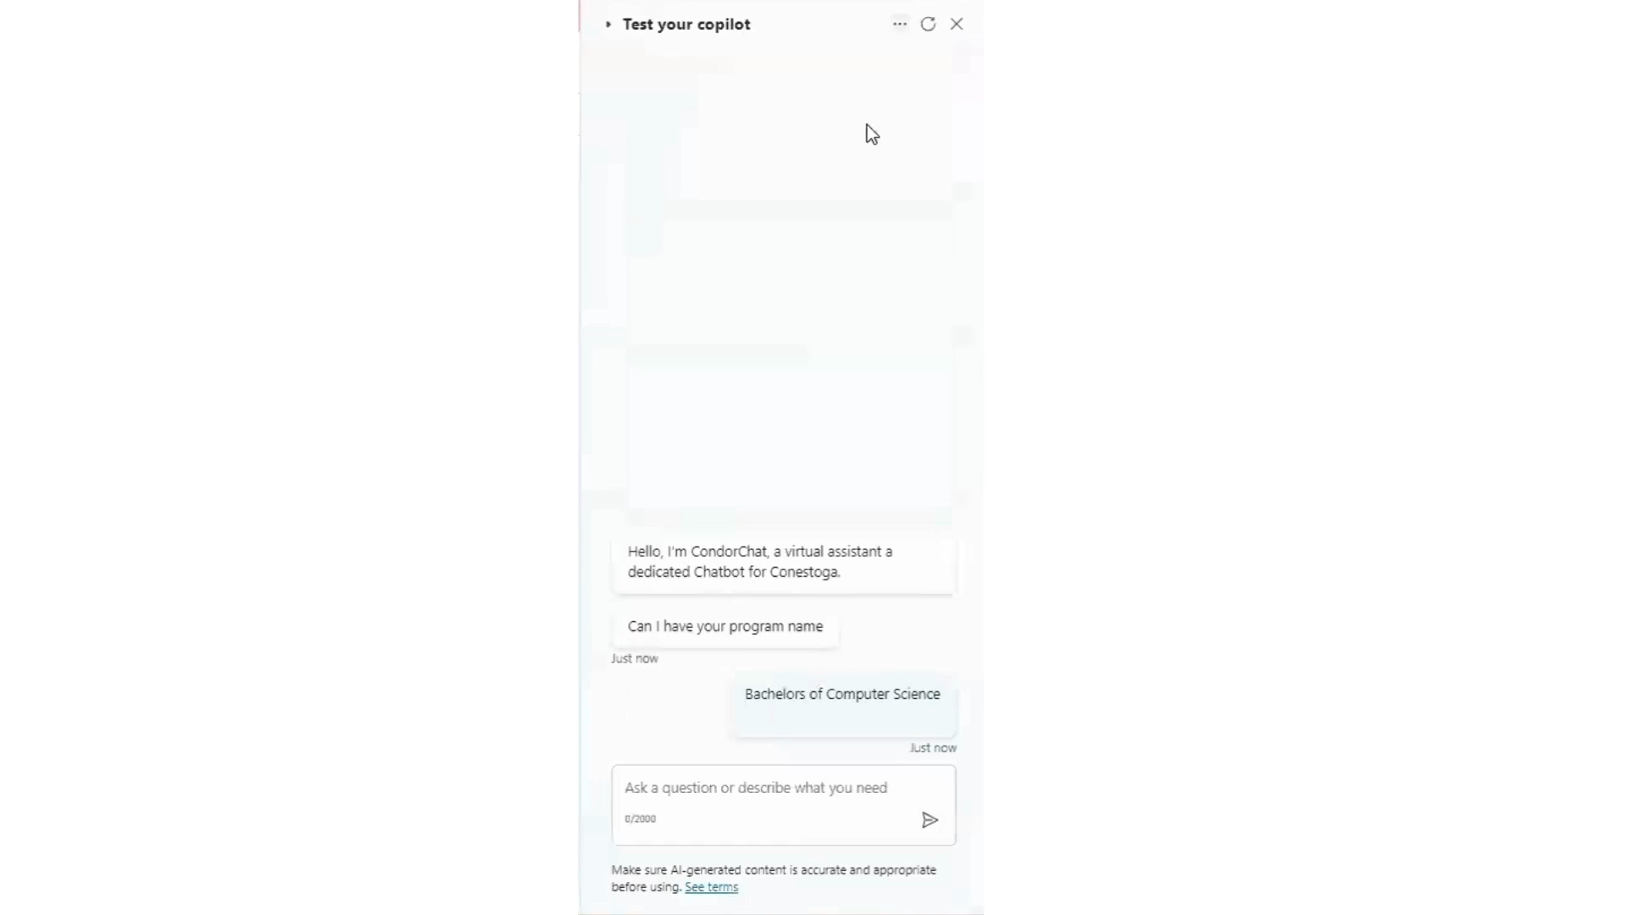
Demo time
Notes:
We introduce the user to the chatbot which is currently named as CondorBot and it prompts and waits for the user to enter the program they belong to.
Which creates a trigger, and it responds back with a brief summary about the courses included in the program and it references all the files that were used to retrieve the information each time.
We then asked it to give the name of the faculty for my courses, as we did not mention any specific course at all, the model analyzes this and gives us all the faculties that have been mentioned in the course outlines. Here we receive only 2 faculty names as the courses provided were limited and the faculty were the same in couple of them.
When we ask specifically for week 4 in the courses, we get a brief summary of what to expect and what assignments are to be submitted along with the references to the course outline files.
When we ask about the assignments due in the week 4 without explicitly mentioning it, the model is able to understand what is asked with the help of the chat history.
Here are couple of other queries for which we received responses which included all the necessary details.
When we ask for a study plan, it analyses that we are asking for week 9 specifically and it plans it such that we sufficient time to review and submit each assignment.
Finally we experimented with triggers such as when the user says thanks, the chatbot replies with you are welcome.

Slide 7
Next Plan
Include Course Outline in our dataset.
Enhancing speed and accuracy in obtaining responses and uploading data.
Working to get responses of Level 2 from DTA Scale from LLaMa Model.
Notes:
Currently copilot studio has access to only the instructional plans, we plan to include course outlines too.
After we update the dataset, we expect the complexity to slightly increase.
We will be potentially researching about ways to get accurate and relevant responses as after the modification to the dataset we might see a drop in the speed and accuracy.

Slide 8
Q & A

